Slide 1
DS5110 Final Project:
MassWeatherHub
Weather Data Integration Pipeline
Rohit Hooda, Rimsha Kayastha, Tri Watanasuparp

Slide 2
TABLE OF CONTENTS
01
02
03
INTRODUCTION
LITERATURE REVIEW
METHODOLOGY
04
05
06
ANALYSIS & RESULTS
DISCUSSION
CONCLUSION

Slide 3
01
Introduction
Objectives and Goals

Slide 4
Objectives & Goals
Develop data integration pipeline combining data from APIs, historical datasets
Create dashboard offering a comprehensive view of environmental trends
Ensure data is clean, accurate, and analysis ready
Deliver user-friendly visualizations for interpreting weather data

Slide 5
Project Scope
Geographical focus: Massachusetts counties
Data range: Historical (January 1, 2022– Oct 30, 2024), real-time, and 7-day forecast data

Slide 6
02
LITERATURE REVIEW
Summary and Relation to Relevant Work

Slide 7
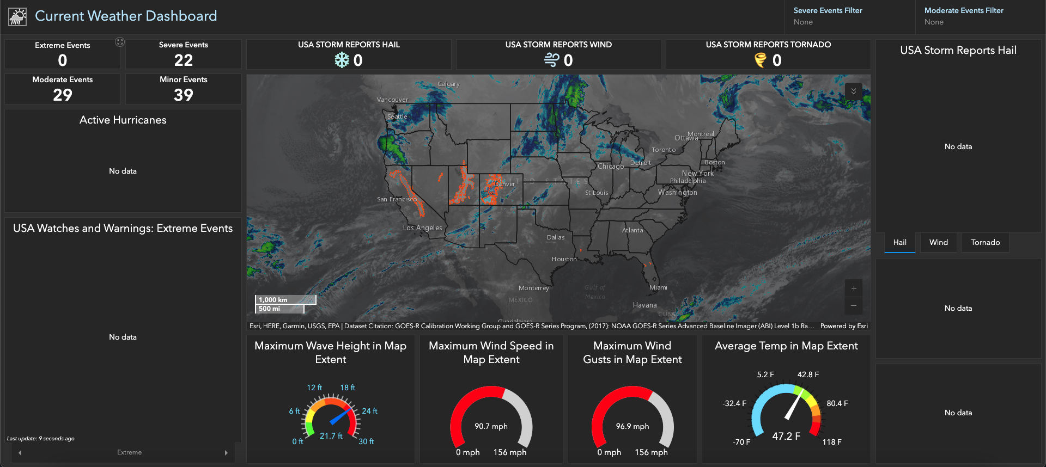
Arcgis Dashboard
The ArcGIS Weather Dashboard provides real-time U.S. weather alerts, including storms, heat waves, and hurricanes, through an interactive map
Notes:
Remember to add what they lack

Slide 8
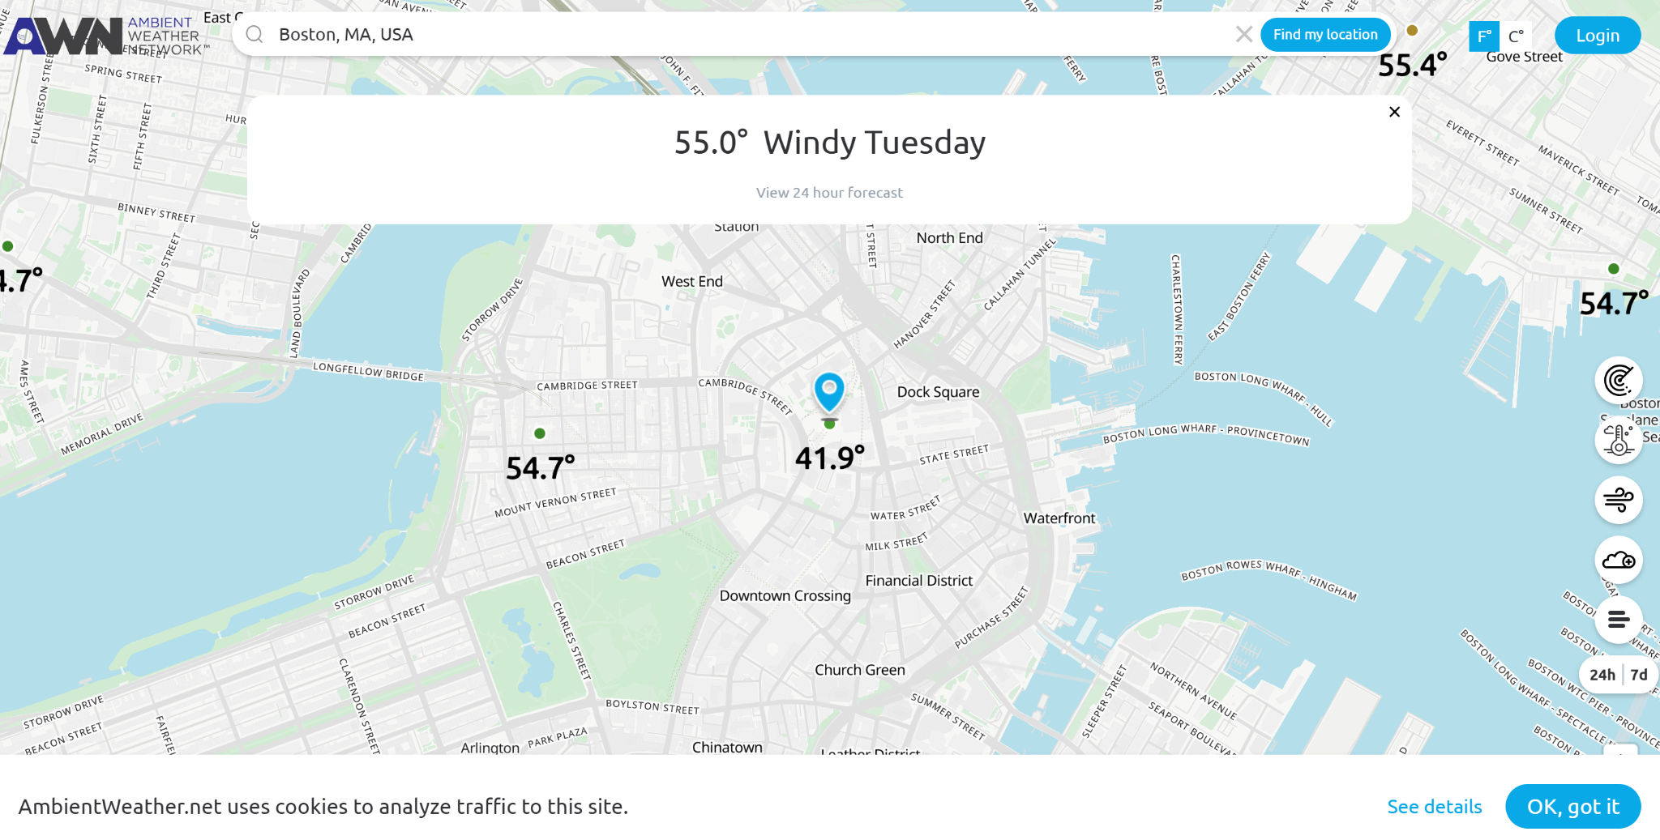
Ambient Weather Dashboard
The Ambient Weather Dashboard delivers hyper-local, real-time weather data from personal weather stations, tracking metrics like temperature, humidity, wind speed, and rainfall
Notes:
Remember to add what it lacks

Slide 9
03
METHODOLOGY
Methods and Techniques Used

Slide 10
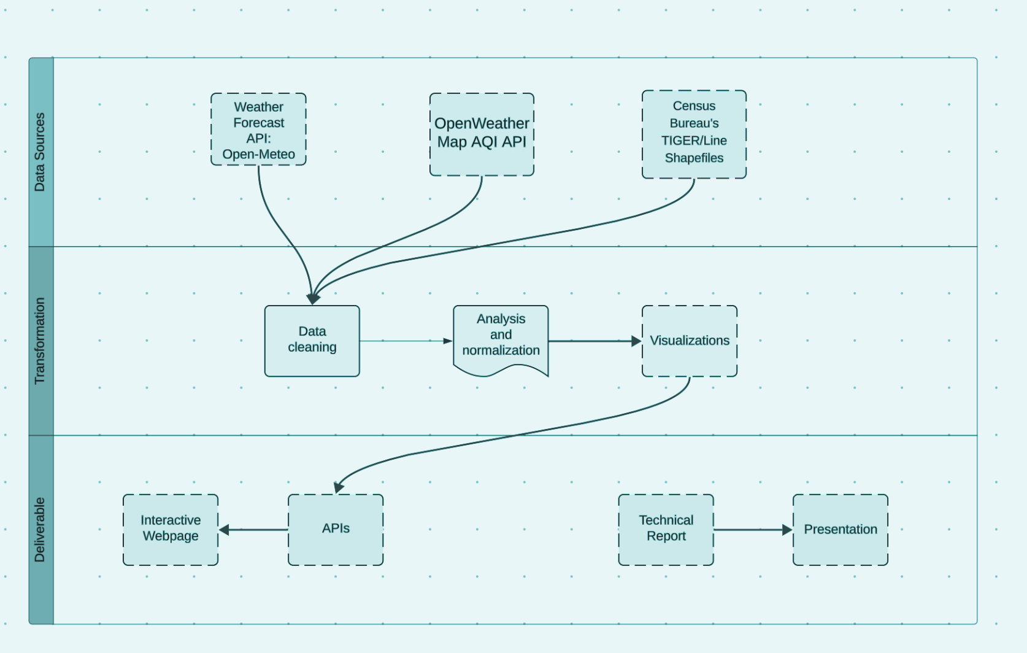
Data extraction from Open-Meteo API, OpenWeather API, and MassGIS shapefiles
Transformation: Cleaning, normalization, and geospatial alignment
Deliverables: Integration pipeline to merge datasets into unified, readable formats

Slide 11
04
DATA ANALYSIS & RESULTS
Key Findings and Insights

Slide 12
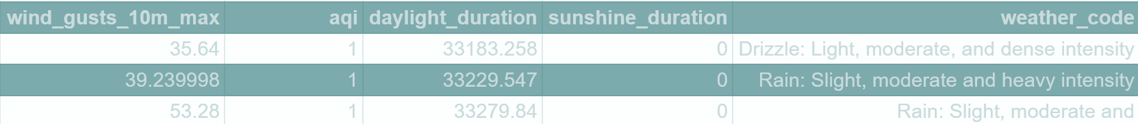
Selected Attributes
Date
County (name)
Latitude/longitude
Temperature (min/max)
Humidity
Wind Speed
Wind Gust
Weather Code
UV Index
Sunrise/Sunset
MA Counties Shapefiles
Air Quality Index

Slide 13
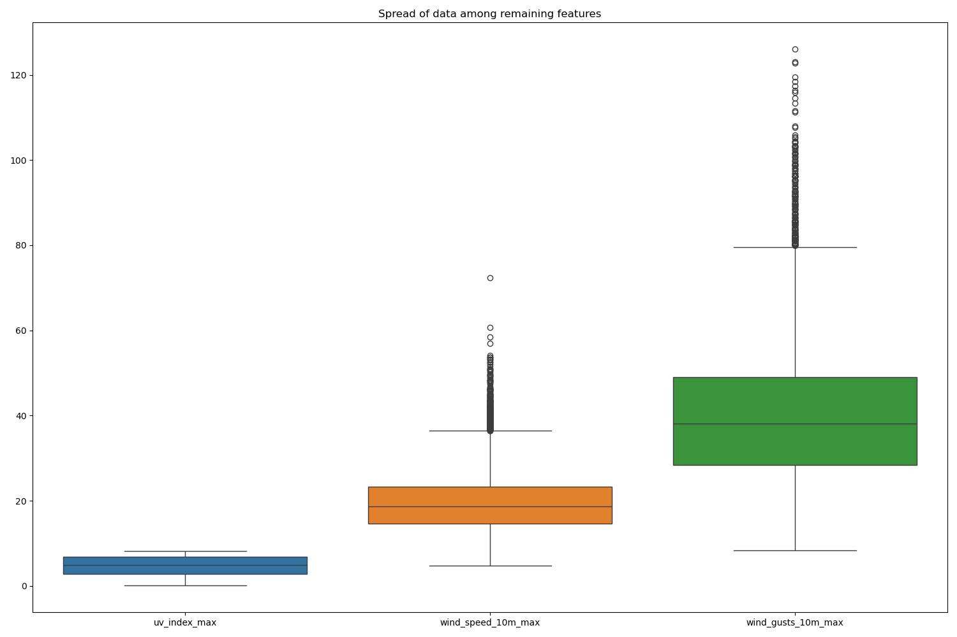
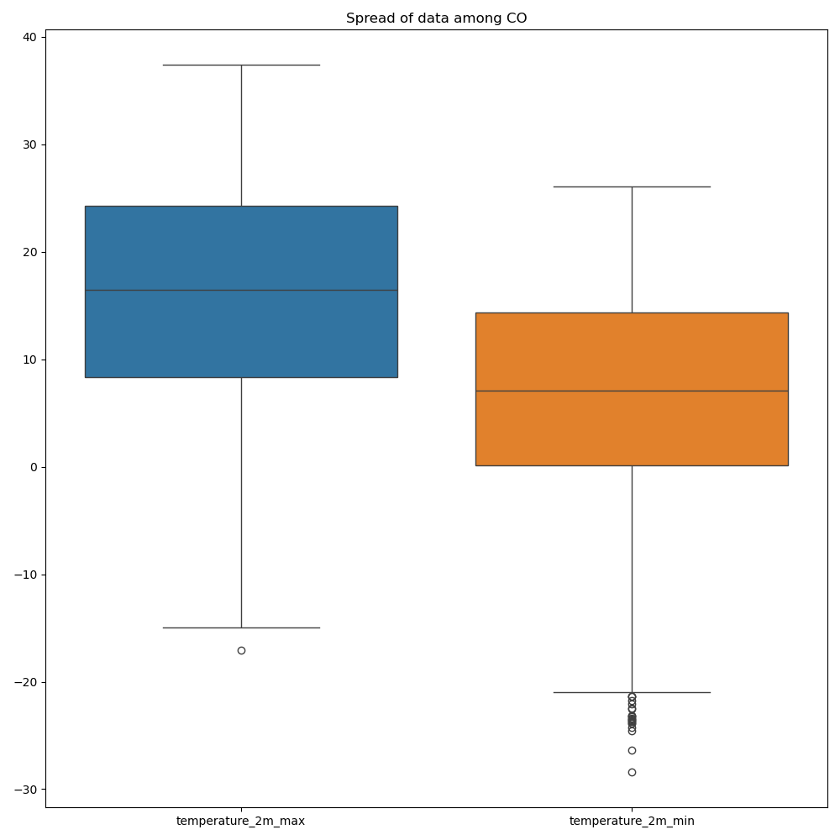
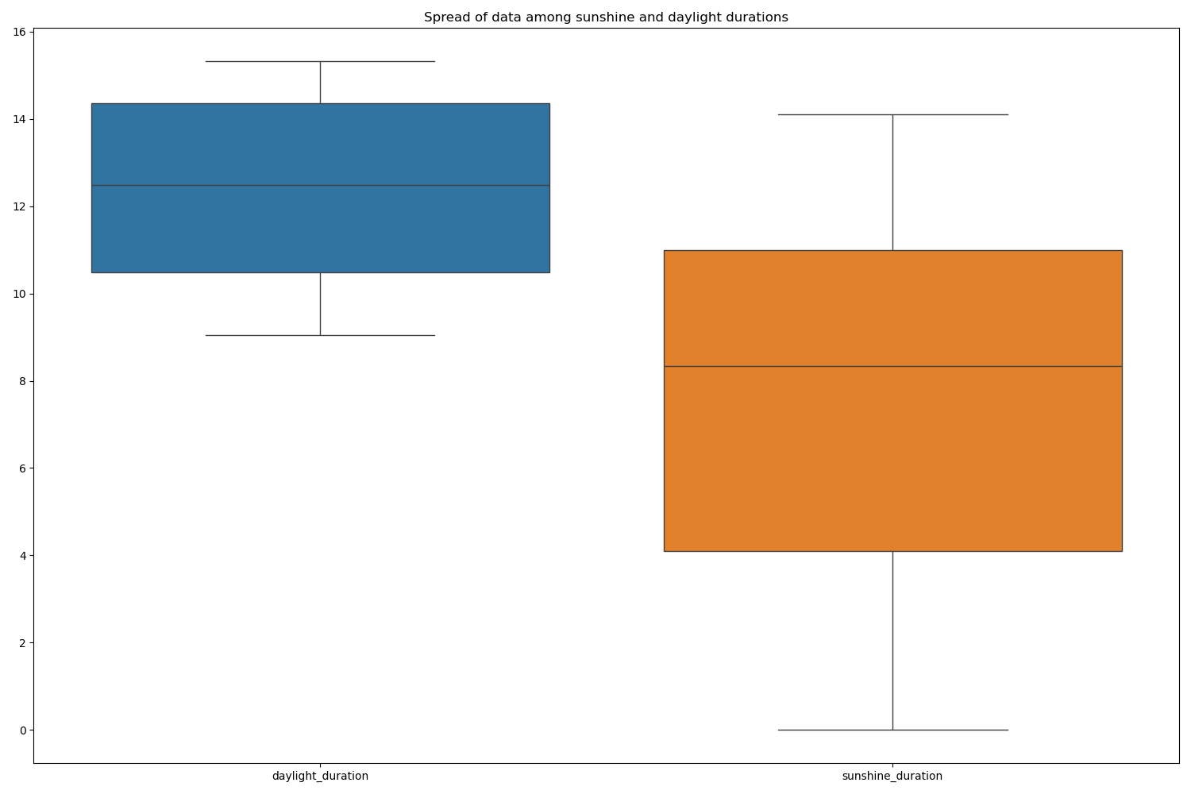
Data Cleaning
Outliers
Scaling

Slide 14
Architecture Diagram

Slide 15
DEMO TIME!

Slide 16
05
DISCUSSION
Implications of Findings,
Project Limitations

Slide 17
Project Limitations
Only a few reliable data sources for weather
Limited Historical Data (Jan. 1, 2022 to Oct. 30, 2024)
Only information available for Massachusetts counties
API Rate Limits for Open-Mateo and OpenWeatherMap
(***Implications of Findings: Discussed during the Demo)

Slide 18
CONCLUSION
06
Conclusions and Recommendations for Future Work

Slide 19
Future Work
Expand weather app coverage to all U.S. states
Integrate additional data sources and features
Enable data retrieval via user’s current location
Host the website on the cloud
Integrate email subscription for weather alerts

Slide 20
07
REFERENCES
Sources

Slide 21
Sources
Open-Meteo API
MassGIS shapefiles
NOAA (2023). Weather Data API Documentation.
OpenWeatherMap (2024). Historical Data Overview.

Slide 22
Thank you for listening!
Any Questions?

